Slide 1
Discrete Structures
CS-1005
GCR: e2d2awt
Lecture-8

Slide 2
Example – A Valid Argument with a False Premise and a False Conclusion
The argument below is valid by modus ponens. But its major premise is false, and so is its conclusion.
If John Lennon was a rock star, then John Lennon had red hair.
John Lennon was a rock star.
John Lennon had red hair.

Slide 3
Example – An Invalid Argument with True Premises and a True Conclusion
The argument below is invalid by the converse error, but it has a true conclusion.
If New York is a big city, then New York has tall buildings.
New York has tall buildings.
New York is a big city.

Slide 4
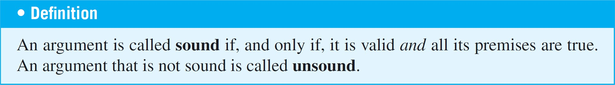
Sound Arguments

Slide 5
Sound Arguments
Sometimes people lump together the ideas of validity and truth. If an argument seems valid, they accept the conclusion as true. And if an argument seems fishy (really a slang expression for invalid), they think the conclusion must be false. This is not correct!
An argument is called sound if, only if,
1 It is valid, and
2 All its premises are true.
Example
If John Lennon was a rock star, then John Lennon had red hair. John Lennon was a rock star.
∴ John Lennon had red hair.
An argument that is not sound is called unsound.

Slide 6
Sound Arguments
An argument is called sound if, only if,
1 It is valid, and
2 All its premises are true.
Example
Daffy Duck is a duck.
All ducks are mammals.
Therefore, Daffy Duck is a mammal.
Example
All rabbits are mammals.
2. Bugs Bunny is a rabbit.
3. Therefore, Bugs Bunny is a mammal.

Slide 7
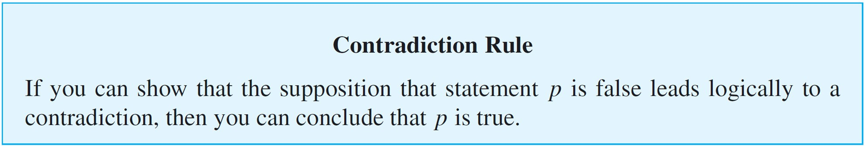
Contradiction Rule
The concept of logical contradiction can be used to make inferences through a technique of reasoning called the contradiction rule. Suppose p is some statement whose truth you wish to deduce.

Slide 8
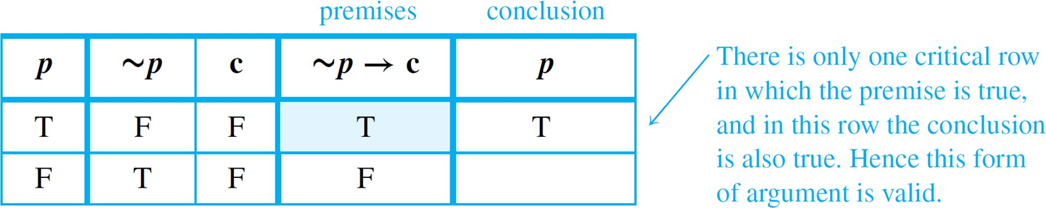
Contradiction Rule
Show that the following argument form is valid:
∼p → c, where c is a contradiction
∴ p
Solution:
Construct a truth table for the premise and the conclusion of this argument.
If “Today is not Friday” is false
∴ Today is Friday

Slide 9
Contradiction Rule
The contradiction rule is the logical heart of the method of proof by contradiction.
A slight variation also provides the basis for solving many logical puzzles by eliminating contradictory answers: If an assumption leads to a contradiction, then that assumption must be false.

Slide 10
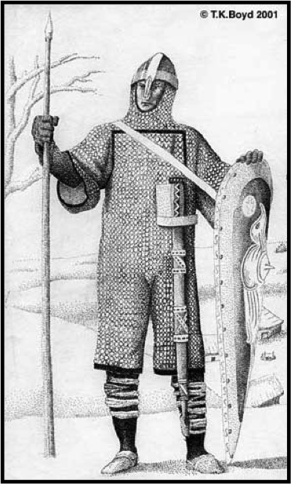
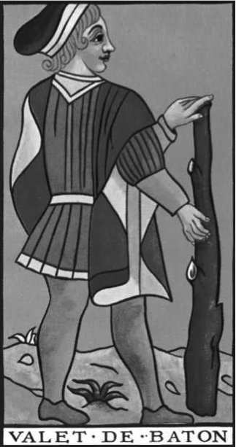
Logic Puzzles
The Island of Knights and Knaves, created by Smullyan.
A says: B is a knight.
B says: A and I are different. What are A and B?
Knaves always lie.
Knights never lie.

Slide 11
Logic Puzzles
A and B are both knaves. To see this, reason as follows:
Suppose A is a knight.
∴ What A says is true. by definition of knight
∴ B is also a knight. That’s what A said.
∴ What B says is true. by definition of knight
∴ A and B are of opposite types. That’s what B said.
∴ We have arrived at the following contradiction: A and B
are both knights and A and B are of opposite type.
∴ The supposition is false . by the contradiction rule
∴ A is not a knight. negation of supposition
∴ A is a knave. by elimination:It’s given that all inhabitants are knights or knaves, so since A is not a
knight, A is a knave.
∴ What A says is false.
∴ B is not a knight.
∴ B is also a knave. by elimination
This reasoning shows that if the problem has a solution at all, then A and B must both
be knaves. It is conceivable, however, that the problem has no solution. The problem
statement could be inherently contradictory. If you look back at the solution, though, you
can see that it does work out for both A and B to be knaves.

Slide 12
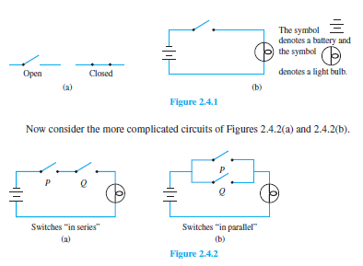
Application: Digital Logic Circuit

Slide 13
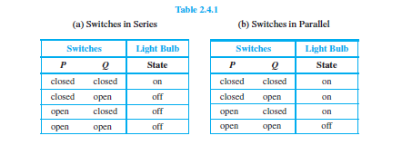
Application: Digital Logic Circuit

Slide 14
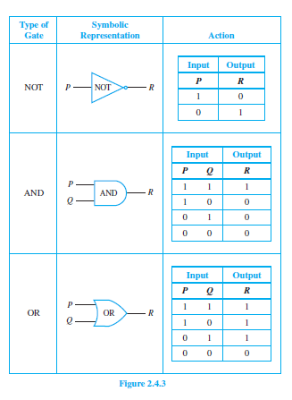
Application: Digital Logic Circuit

Slide 15
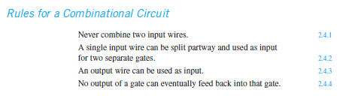
Application: Digital Logic Circuit

Slide 16
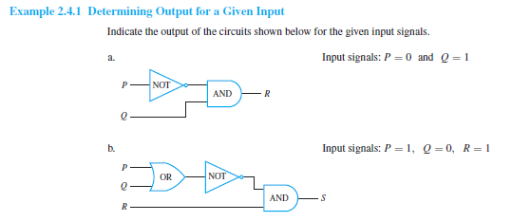
Application: Digital Logic Circuit

Slide 17
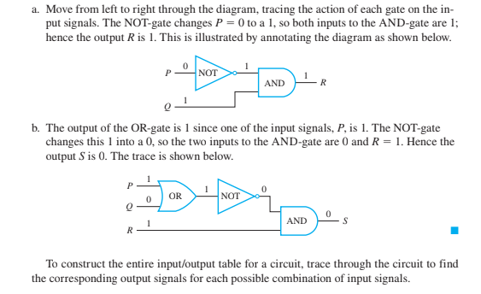
Application: Digital Logic Circuit

Slide 18
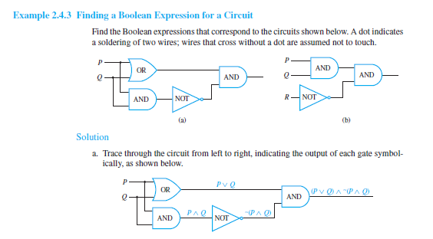
Application: Digital Logic Circuit

Slide 19
Application: Digital Logic Circuit

Slide 20
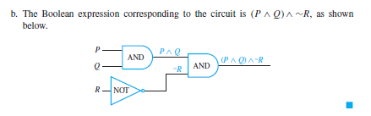
Application: Digital Logic Circuit

Slide 21
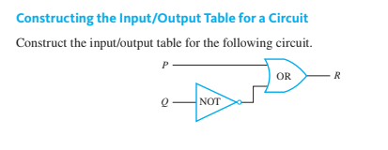
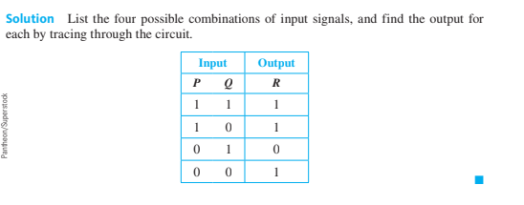
Application: Digital Logic Circuit

Slide 22
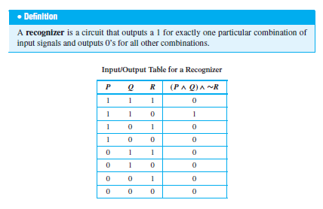
Application: Digital Logic Circuit

Slide 23

Application: Digital Logic Circuit
Constructing Circuits form Boolean
Expresssions.

Slide 24
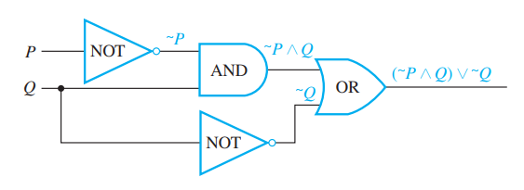
Application: Digital Logic Circuit
Constructing Circuits form Boolean
Expresssions.

Slide 25
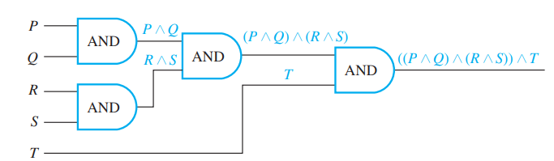
Application: Digital Logic Circuit
Constructing Circuits form Boolean
Expresssions.

Slide 26
Predicates and Quantifiers
Propositional Logic is not expressive enough
It cannot adequately express the meaning of statements in mathematics and in natural language
It lacks the expressiveness to capture the relationships between objects, the properties of objects, or quantify over objects.
Predicate logic, overcomes these limitations by introducing quantifiers, variables, and predicates, which enable more precise representation of mathematical and natural language statements.

Slide 27
Predicates and Quantifiers
Why Predicate Logic?
“All humans are mortal.”
In propositional logic, we can represent only atomic facts like:
H: Human exist.
M: Human are mortal.
Propositional logic might express this as something like H->M (If humans exist, then they are mortal). But this doesn't capture the meaning that every single human is mortal.

Slide 28
Predicates and Quantifiers
Why Predicate Logic?
Propositional logic can only represent basic true/false propositions and lacks the power to express more complex relationships or quantify over objects.
Predicate logic introduces quantifiers, predicates, and variables, allowing it to express statements about individual objects, relationships between them, and their properties, making it more suitable for both mathematics and natural language

Slide 29
Predicates and Quantifiers
Proposition, YES or NO?
3 + 2 = 5
X + 2 = 5
X + 2 = 5 for any choice of X in {1, 2, 3}
X + 4 = 5 for some X in {1, 2, 3}
Computer X is under attack by an intruder

Slide 30
Predicates and Quantifiers
In grammar, the word predicate refers to the part of a sentence that gives information about the subject.
“James is a student at Bedford College”
James is the subject and the phrase is a student at Bedford College is the predicate. The predicate is the part of the sentence from which the subject has been removed.
The sentences “x is a student at Bedford College” and “x is a student at y” are symbolized as P(x) and as Q(x, y), respectively, where x and y are predicate variables that take values in appropriate sets.

Slide 31
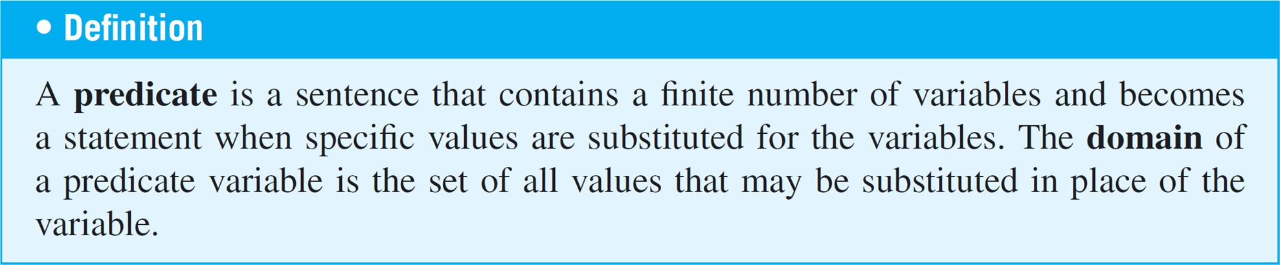
Predicates and Quantifiers
For simplicity, we define a predicate to be a predicate symbol together with suitable predicate variables. In some other treatments of logic, such objects are referred to as propositional functions or open sentences.

Slide 32
Predicates and Quantifiers
Propositional Functions
“x is greater than 3” or (x > 3)
The variable x: subject of the statement
“is greater than 3”: predicate
P(x): propositional function P at x
Let P(x) = x > 3
P(x) has no truth values (x is not given a value)
P(10) is true: The proposition 10 > 3 is true.
P(1) is false: The proposition 1 > 3 is false.
P(x) will create a proposition when given a value

Slide 33
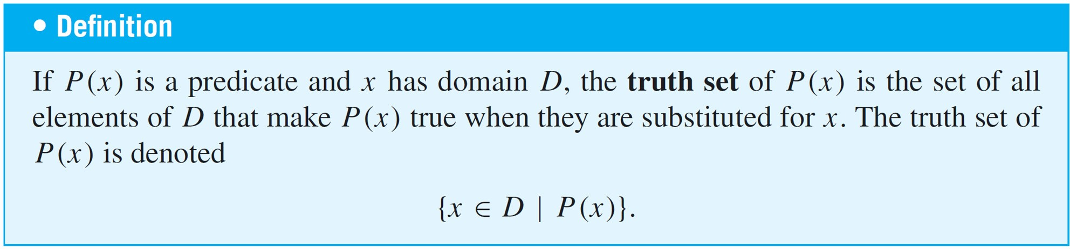
Predicates and Quantifiers
When an element in the domain of the variable of a one-variable predicate is substituted for the variable, the resulting statement is either true or false. The set of all such elements that make the predicate true is called the truth set of the predicate.

Slide 34
Predicates and Quantifiers
Let Q(n) be the predicate “n is a factor of 8.” Find the truth set of Q(n) if
the domain of n is the set Z⁺ of all positive integers
the domain of n is the set Z of all integers.
Solution:
The truth set is {1, 2, 4, 8} because these are exactly the positive integers that divide 8 evenly.
The truth set is {1, 2, 4, 8,−1,−2,−4,−8} because the negative integers −1,−2,−4, and −8 also divide into 8 without leaving a remainder.

Slide 35
Predicates and Quantifiers
A predicate is a declarative statement with at least one variable (i.e. unknown value).
A predicate, or propositional function, is a function that takes some variable(s) as arguments and returns True or False.
One sure way to change predicates into statements is to assign specific values to all their variables.
For example, if x represents the number 35, the sentence “x is (evenly) divisible by 5” is a true statement since 35 = 5 • 7. Another way to obtain statements from predicates is to add quantifiers.
Quantifiers are words that refer to quantities such as “some” or “all” and tell for how many elements a given predicate is true.

Slide 36
The Universal Quantifier
The symbol ∀ denotes “for all” and is called the universal quantifier.
The domain of the predicate variable is generally indicated between the ∀ symbol and the variable name or immediately following the variable name. Some other expressions that can be used instead of for all are for every, for arbitrary, for any, for each, and given any.

Slide 37
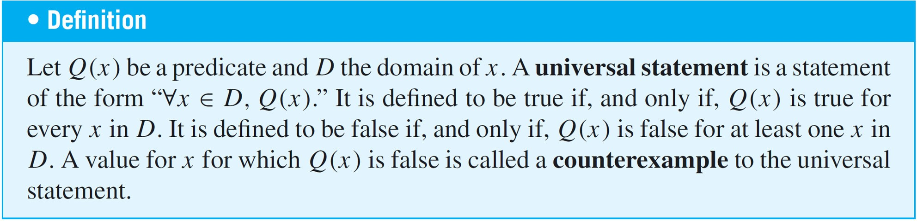
The Universal Quantifier
Sentences that are quantified universally are defined as statements by giving them the truth values specified in the following definition:

Slide 38


The Universal Quantifier
Let D = {1, 2, 3, 4, 5}, and consider the statement
Show that this statement is true.
Consider the statement
Find a counterexample to show that this statement is false.

Slide 39
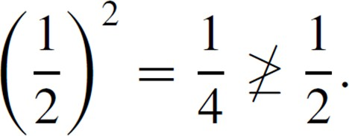
The Universal Quantifier
a. Check that “x² ≥ x” is true for each individual x in D.
Hence “∀x ∈ D, x² ≥ x” is true.
b. Counterexample: Take x = a real number) and
. Then x is in R (since is
Hence “∀x ∈ R, x² ≥ x” is false.

Slide 40
The Universal Quantifier
The technique used to show the truth of the universal statement in Example 3(a) is called the method of exhaustion.
It consists of showing the truth of the predicate separately for each individual element of the domain.
This method can, in theory, be used whenever the domain of the predicate variable is finite.

Slide 41
The Existential Quantifier
The symbol ∃ denotes “there exists” and is called the existential quantifier. For example, the sentence “There is a student in Math 140” can be written as
∃ a person p such that p is a student in Math 140, or, more formally,
∃ p ∈ P such that p is a student in Math 140, where P is the set of all people.

Slide 42
The Existential Quantifier
The words such that are inserted just before the predicate. Some other expressions that can be used in place of there exists are there is a, we can find a, there is at least one, for some, and for at least one.
In a sentence such as “∃ integers m and n such that
m + n = m • n,” the ∃ symbol is understood to refer to both
m and n.

Slide 43
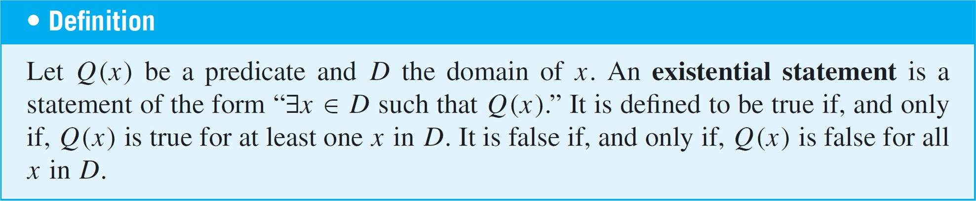
The Existential Quantifier

Slide 44
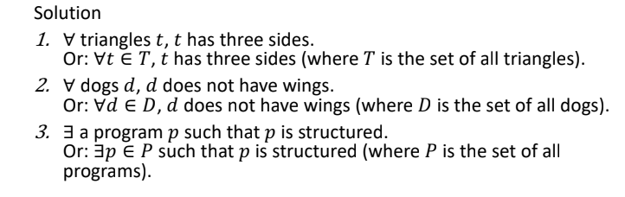
The Existential Quantifier
Example: Translating from Informal to Formal Language
Rewrite each of the following statements formally. Use quantifiers and variables.
1. All triangles have three sides.
2. No dogs have wings.
3. Some programs are structured.

Slide 45


The Existential Quantifier
Rewrite the following formal statements in a variety of equivalent but more informal ways. Do not use the symbol ∀ or ∃.
a.
b.
All real numbers have nonnegative squares.
Or: Every real number has a nonnegative square.
Or: Any real number has a nonnegative square.
Or: The square of each real number is nonnegative.
All real numbers have squares that are not equal to −1.
Or: No real numbers have squares equal to −1.
(The words none are or no . . . are are equivalent to the words all are not.)

Slide 46
Universal Conditional Statements
A reasonable argument can be made that the most important form of statement in mathematics is the universal conditional statement:
∀x, if P(x) then Q(x).
Familiarity with statements of this form is essential if you are to learn to speak mathematics.

Slide 47
Universal Conditional Statements
Rewrite the following statement informally, without quantifiers or variables.
∀ x ∈ R, if x > 2 then x² > 4.
Solution:
If a real number is greater than 2 then its square is greater than 4.
Or: Whenever a real number is greater than 2, its square is greater than 4.

Slide 48

Equivalent Forms of Universal and Existential Statements
Observe that the two statements “∀ real numbers x, if x is an integer then x is rational” and “∀ integers x, x is rational” mean the same thing.
Both have informal translations “All integers are rational.” In fact, a statement of the form
can always be rewritten in the form
by narrowing U to be the domain D consisting of all values of the variable x that make P(x) true.

Slide 49

Equivalent Forms of Universal and Existential Statements
Conversely, a statement of the form
can be rewritten as

Slide 50
Equivalent Forms of Universal and Existential Statements
Rewrite the following statement in the two forms “∀ x, if then ” and “∀ x, ”: All squares are rectangles.
Solution:
∀x, if x is a square then x is a rectangle.
∀ squares x, x is a rectangle.

Slide 51
Equivalent Forms of Universal and Existential Statements
Similarly, a statement of the form
“∃ x such that p(x) and Q(x)”
can be rewritten as
“∃ x εD such that Q(x),”
where D is the set of all x for which P(x) is true.

Slide 52
Equivalent Forms of Universal and Existential Statements
A prime number is an integer greater than 1 whose only positive integer factors are itself and 1. Consider the statement “There is an integer that is both prime and even.”
Let Prime(n) be “n is prime” and Even(n) be “n is even.” Use the notation Prime(n) and Even(n) to rewrite this statement in the following two forms:
∃ n such that ∧ .
∃ n such that .

Slide 53
Equivalent Forms of Universal and Existential Statements
∃ n such that Prime(n) ∧ Even(n).
Two answers: ∃ a prime number n such that Even(n).
∃ an even number n such that Prime(n).

Slide 54
Implicit Quantification
Mathematical writing contains many examples of implicitly quantified statements. Some occur, through the presence of the word a or an. Others occur in cases where the general context of a sentence supplies part of its meaning.
For example, in an algebra course in which the letter x is always used to indicate a real number, the predicate
If x > 2 then x² > 4
is interpreted to mean the same as the statement
∀ real numbers x, if x > 2 then x² > 4.

Slide 55
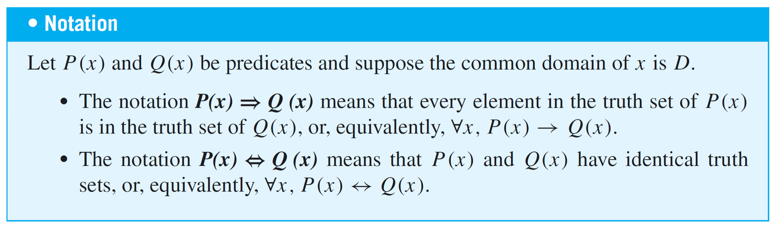
Implicit Quantification
Mathematicians often use a double arrow to indicate implicit quantification symbolically.
For instance, they might express the above statement as
x > 2 ⇒ x² > 4.

Slide 56
Tarski’s World
Tarski’s World is a computer program developed by information scientists Jon Barwise and John Etchemendy to help teach the principles of logic.
It is described in their book The Language of First-Order Logic, which is accompanied by a CD-Rom containing the program Tarski’s World, named after the great logician Alfred Tarski.

Slide 57
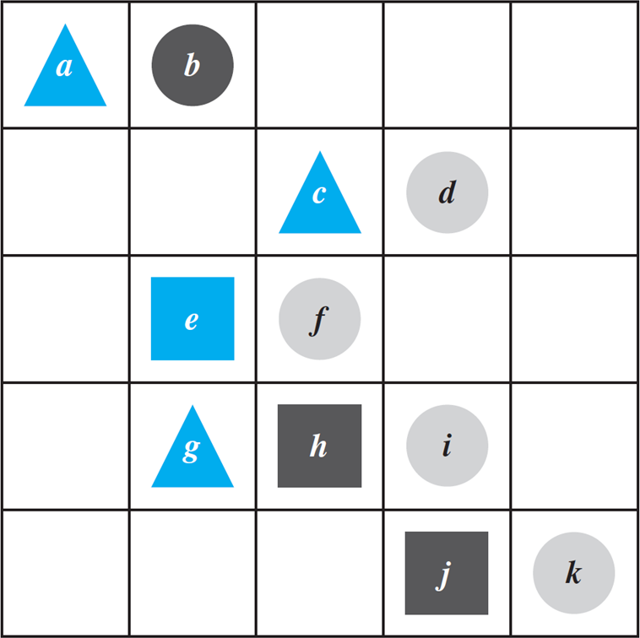
Tarski’s World
The program for Tarski’s World provides pictures of blocks of various sizes, shapes, and colors, which are located on a grid. Shown in Figure is a picture of an arrangement of objects in a two-dimensional Tarski world.

Slide 58
Tarski’s World
The configuration can be described using logical operators and—for the two-dimensional version—notation such as Triangle(x), meaning “x is a triangle,” Blue(y), meaning “y is blue,” and RightOf(x, y), meaning “x is to the right of y (but possibly in a different row).” Individual objects can be given names such as a, b, or c.

Slide 59
Tarski’s World
Determine the truth or falsity of each of the following statements. The domain for all variables is the set of objects in the Tarski world shown above.
∀ t, Triangle(t) → Blue(t).
∀ x, Blue(x) → Triangle(x).
∃ y such that Square(y) ∧ RightOf(d, y).
∃ z such that Square(z) ∧ Gray(z).

Slide 60
Tarski’s World
This statement is true: All the triangles are blue.
This statement is false. As a counterexample, note that e
is blue and it is not a triangle.
This statement is true because e and h are both square and d is to their right.
This statement is false: All the squares are either blue or black.

Slide 61
Negations of Quantified Statements
“All mathematicians wear glasses”
No mathematicians wear glasses?
“There is at least one mathematician who does not wear glasses.”

Slide 62
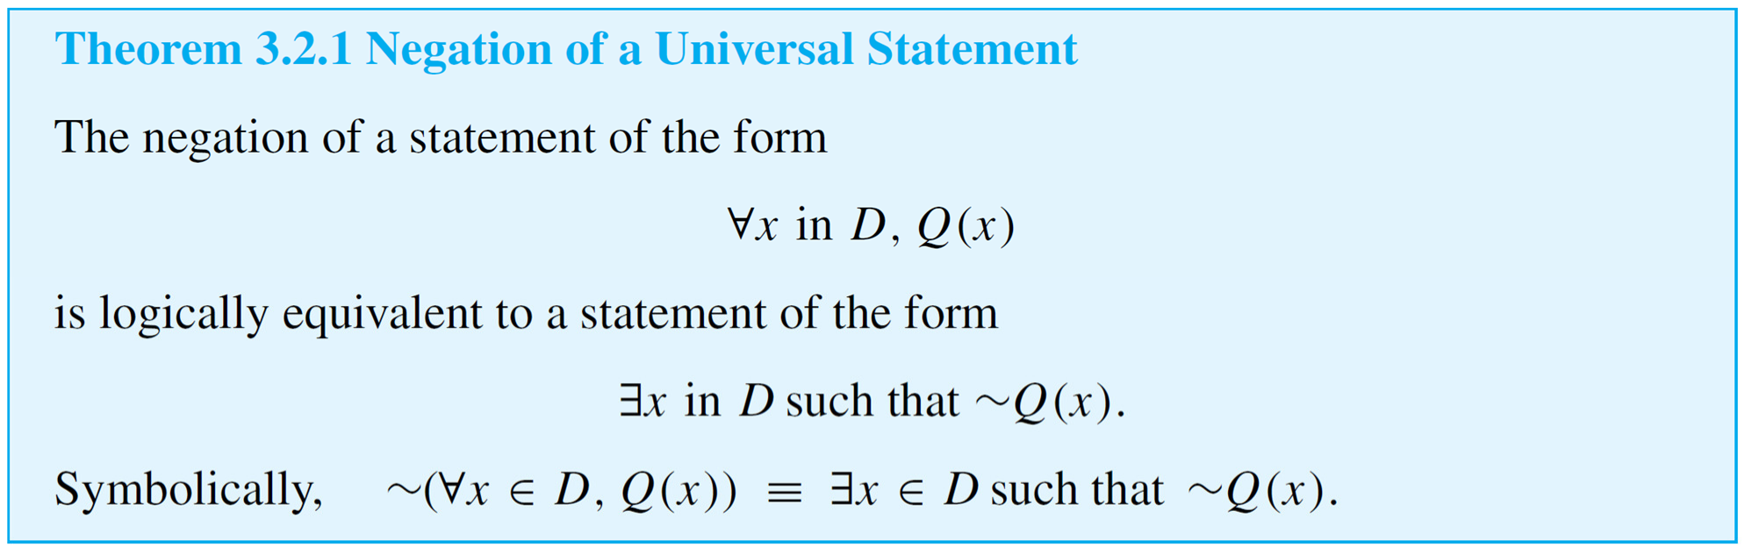
Negations of Quantified Statements
The negation of a universal statement (“all are”) is logically equivalent to an existential statement (“some are not” or “there is at least one that is not”).

Slide 63
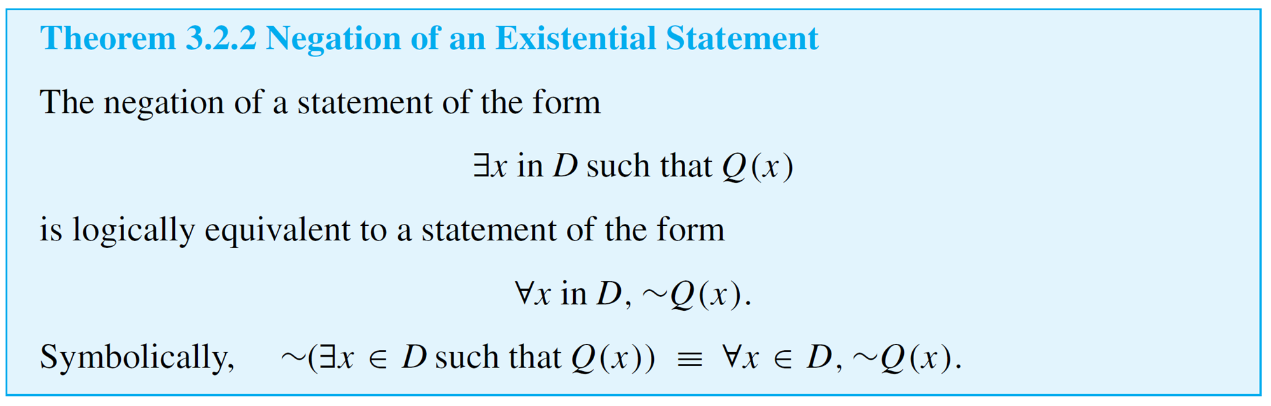
Negations of Quantified Statements
“Some snowflakes are the same.”
“No snowflakes are the same,”
“All snowflakes are different.”
Thus
The negation of an existential statement (“some are”) is logically equivalent to a universal statement (“none are” or “all are not”).

Slide 64
Negations of Quantified Statements
Write formal negations for the following statements:
∀ primes p, p is odd.
∃ a triangle T such that the sum of the angles of T
equals 200°.
Solution:
a. By applying the rule for the negation of a ∀ statement, you can see that the answer is
∃ a prime p such that p is not odd.

Slide 65
Negations of Quantified Statements
b. By applying the rule for the negation of a ∃ statement, you can see that the answer is
∀ triangles T, the sum of the angles of T does not equal 200°.

Slide 66
Quantified Statements
The negation of a for all statement is a there exists statement, and the negation of a there exists statement is a for all statement.
These facts are analogous to De Morgan’s laws, which state that the negation of an and statement is an or statement and that the negation of an or statement is an and statement.
This similarity is not accidental. In a sense, universal statements are generalizations of and statements, and existential statements are generalizations of or statements.

Slide 67

Quantified Statements
If Q(x) is a predicate and the domain D of x is the set {x₁, x₂, . . . , x_{n}}, then the statements
and
are logically equivalent.

Slide 68

Quantified Statements
Similarly, if Q(x) is a predicate and D = {x₁, x₂, . . . , x_{n}}, then the statements
and
are logically equivalent.

Slide 69
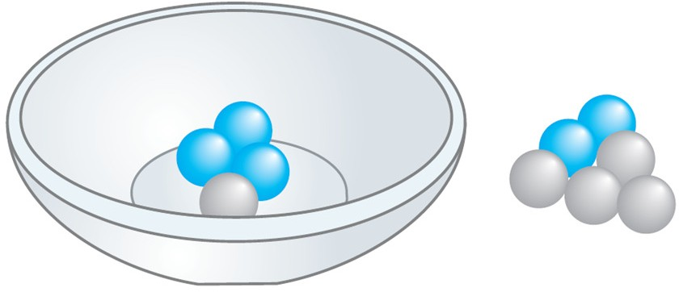
Vacuous Truth of Universal Statements
Suppose a bowl sits on a table and next to the bowl is a pile of five blue and five gray balls, any of which may be placed in the bowl.
If three blue balls and one gray ball are placed in the bowl, as shown in Figure the statement “All the balls in the bowl are blue” would be false (since one of the balls in the bowl is gray).

Slide 70
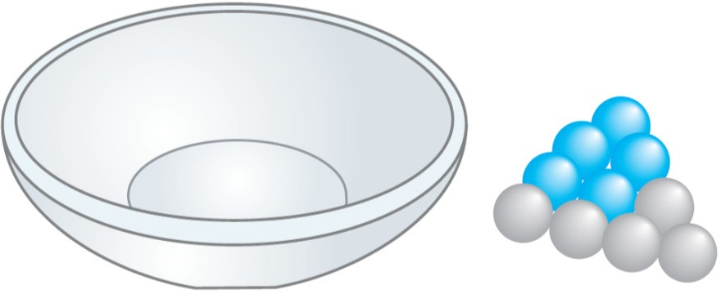
Vacuous Truth of Universal Statements
Now suppose that no balls at all are placed in the bowl, as shown in Figure
Consider the statement
All the balls in the bowl are blue.

Slide 71
Vacuous Truth of Universal Statements
Is this statement true or false? The statement is false if, and only if, its negation is true.
And its negation is
There exists a ball in the bowl that is not blue.
But the only way this negation can be true is for there actually to be a nonblue ball in the bowl.
And there is not! Hence the negation is false, and so the statement is true “by default.”

Slide 72
Vacuous Truth of Universal Statements
In general, a statement of the form
is called vacuously true or true by default if, and only if,
P(x) is false for every x in D.

Slide 73
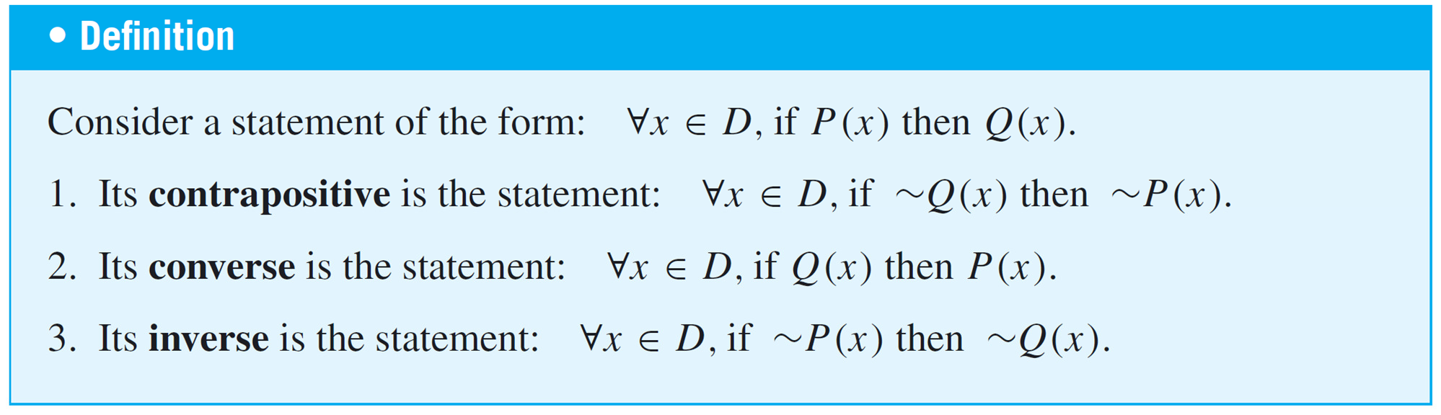
Variants of Universal Conditional Statements
We have known that a conditional statement has a contrapositive, a converse, and an inverse.
The definitions of these terms can be extended to universal conditional statements.

Slide 74
Variants of Universal Conditional Statements
Write a formal and an informal contrapositive, converse, and inverse for the following statement:
If a real number is greater than 2, then its square is greater than 4.
Solution:
The formal version of this statement is
∀x ∈ R, if x > 2 then x² > 4.

Slide 75
Variants of Universal Conditional Statements
Contrapositive: ∀x ∈ R, if x² ≤ 4 then x ≤ 2.
Or: If the square of a real number is less than or equal to 4, then the number is less than or equal to 2.
Converse: ∀x ∈ R, if x² > 4 then x > 2.
Or: If the square of a real number is greater than 4, then the number is greater than 2.
Inverse: ∀x ∈ R, if x ≤ 2 then x² ≤ 4. Or: If a real number is less than or equal to 2, then the square of the number is less than or equal to 4.

